Slide 1

Installing GridLAB-D
This section provides instructions to install and configure your system for GridLAB-D use.

Slide 2
Windows Installation
SourceForge download
  http://sourceforge.net/projects/gridlab-d
Two installation options
  System install: available for all users
    C:\Program Files\GridLAB-D
    Usually requires admin privileges
    Shares modules and runtime files
  Single user install: only available to you
    My Documents\My Programs\GridLAB-D
    Doesn’t require admin privileges
    Keeps libraries and runtime files private

Slide 3
Installation
Student Demo build
    Navigate to the folder where the course material has been unzipped
    Double click on
    gridlabd-win32-2009_07_20-nightly.exe

Slide 4
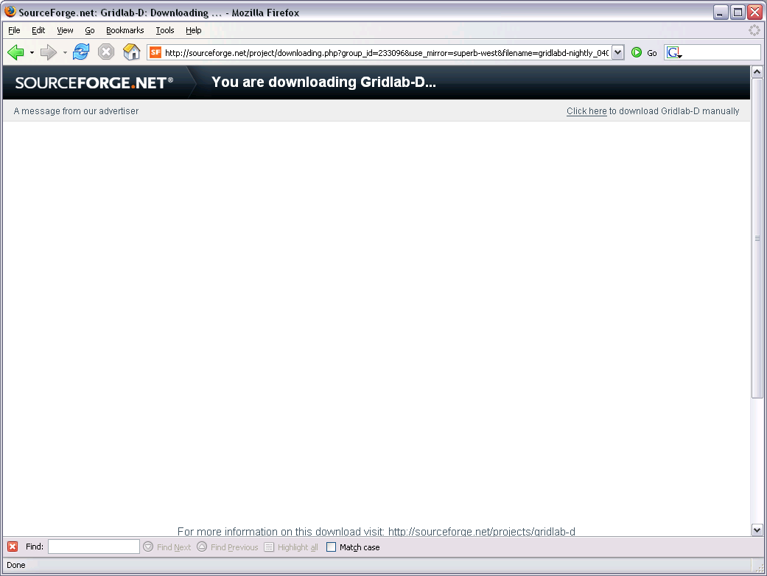
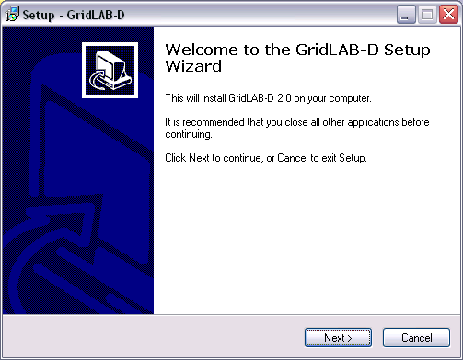

Slide 5
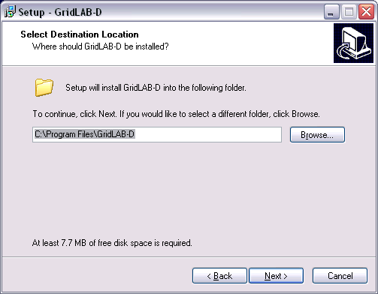

Slide 6
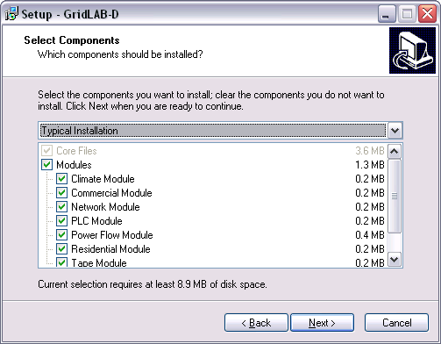

Slide 7
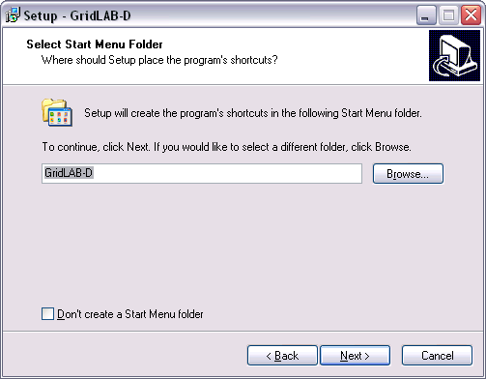

Slide 8
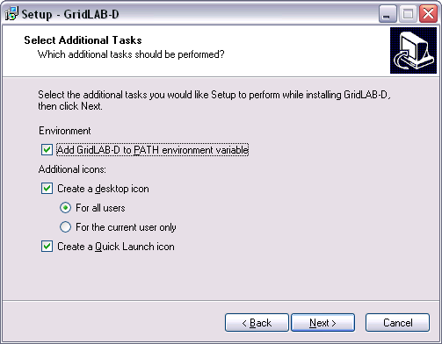

Slide 9
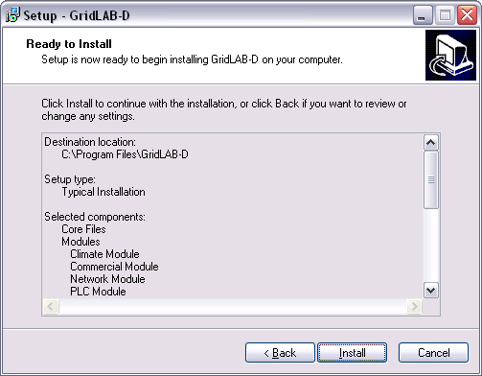

Slide 10
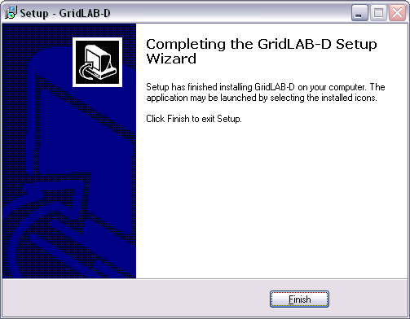

Slide 11
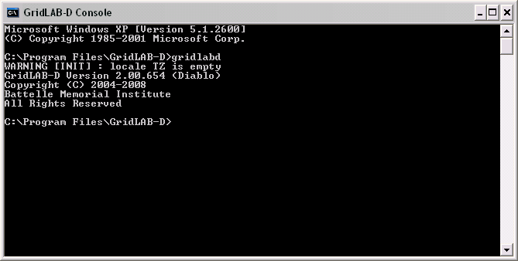
Checking your installation
StartAll ProgramsGridLAB-DGridLAB-D Console

Slide 12
Structure of Installation
…/bin – executables
  Includes gridlabd.exe
…/etc – text-based files and libraries
  Includes weather data, configuration files, etc.
…/lib – binary files and libraries
  Includes all runtime models
…/samples – sample models
Others: textpad, mingw, gnuplot, gdb, etc.

Slide 13
Windows Environment
PATH
  Specifies path to executables and modules
  Must be set before gridlabd start
  Can be modified after gridlabd starts
GLPATH
  Specifies path to libraries and runtime files
  Must be set before gridlabd start
  Can be modified after gridlabd starts
Can be changed from “My Computer”

Slide 14
Textpad install/setup
Textpad editor has helpful customizations
GridLAB-D syntax file
  Highlights GridLAB Module syntax
  Useful for detecting errors
Integrated development environment
  Can run GridLAB-D command from editor
  Gathers output and displays

Slide 15
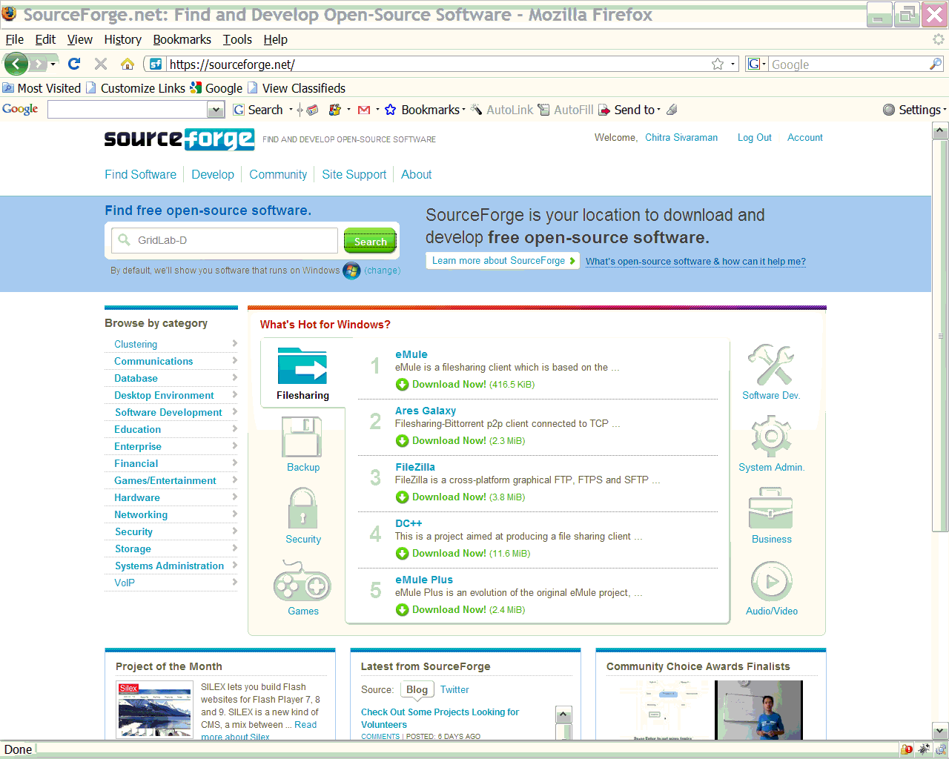

Slide 16
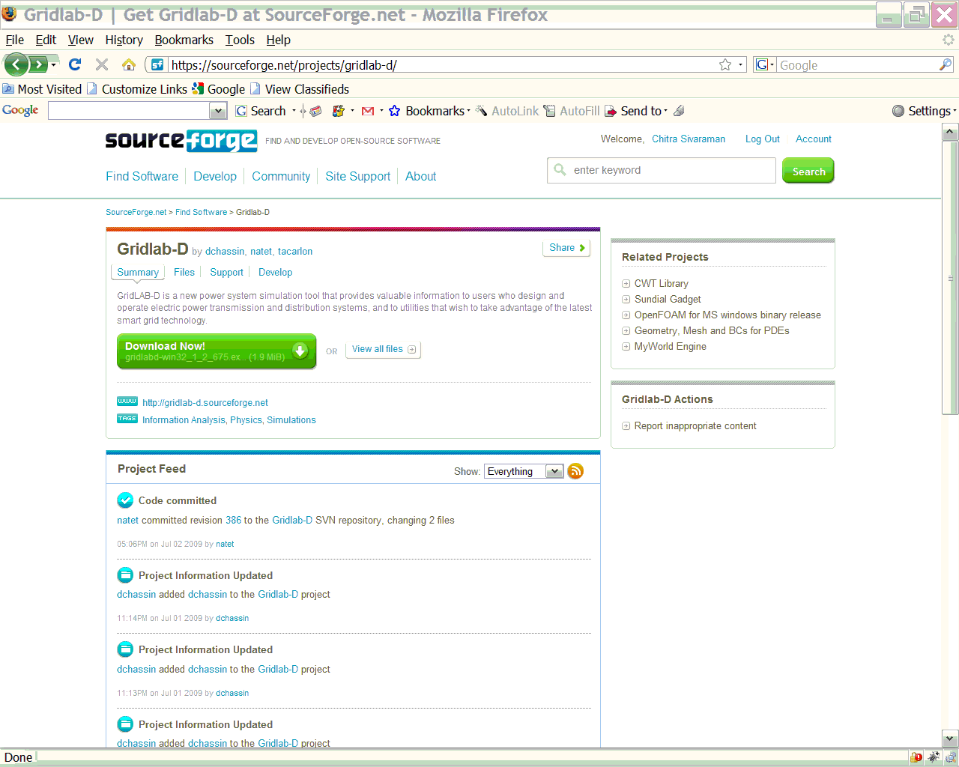

Slide 17
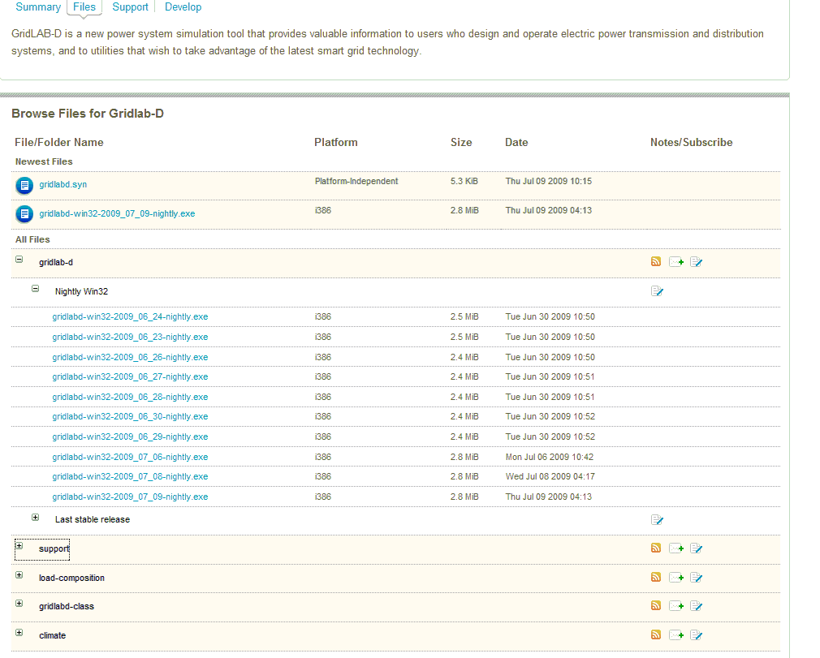

Slide 18
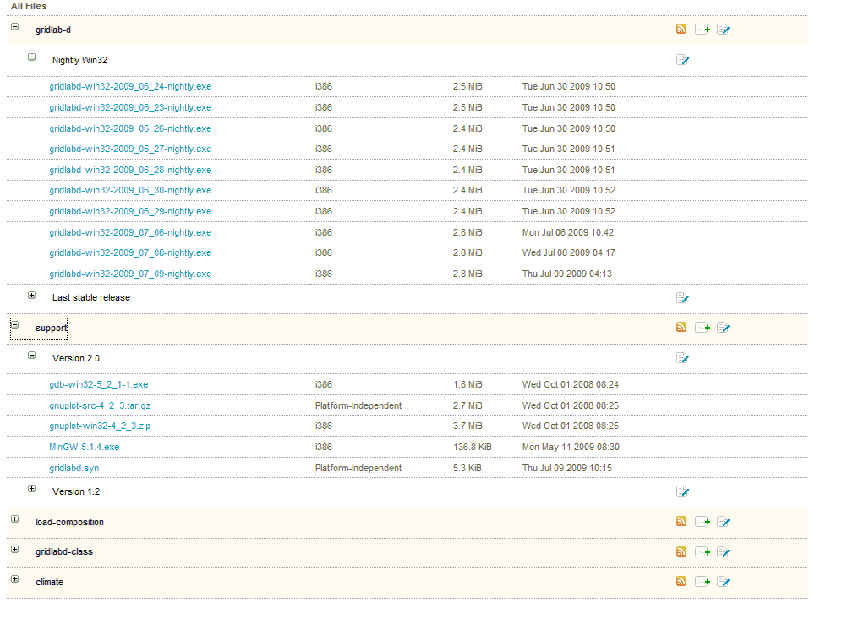
Download the syntax file

Slide 19
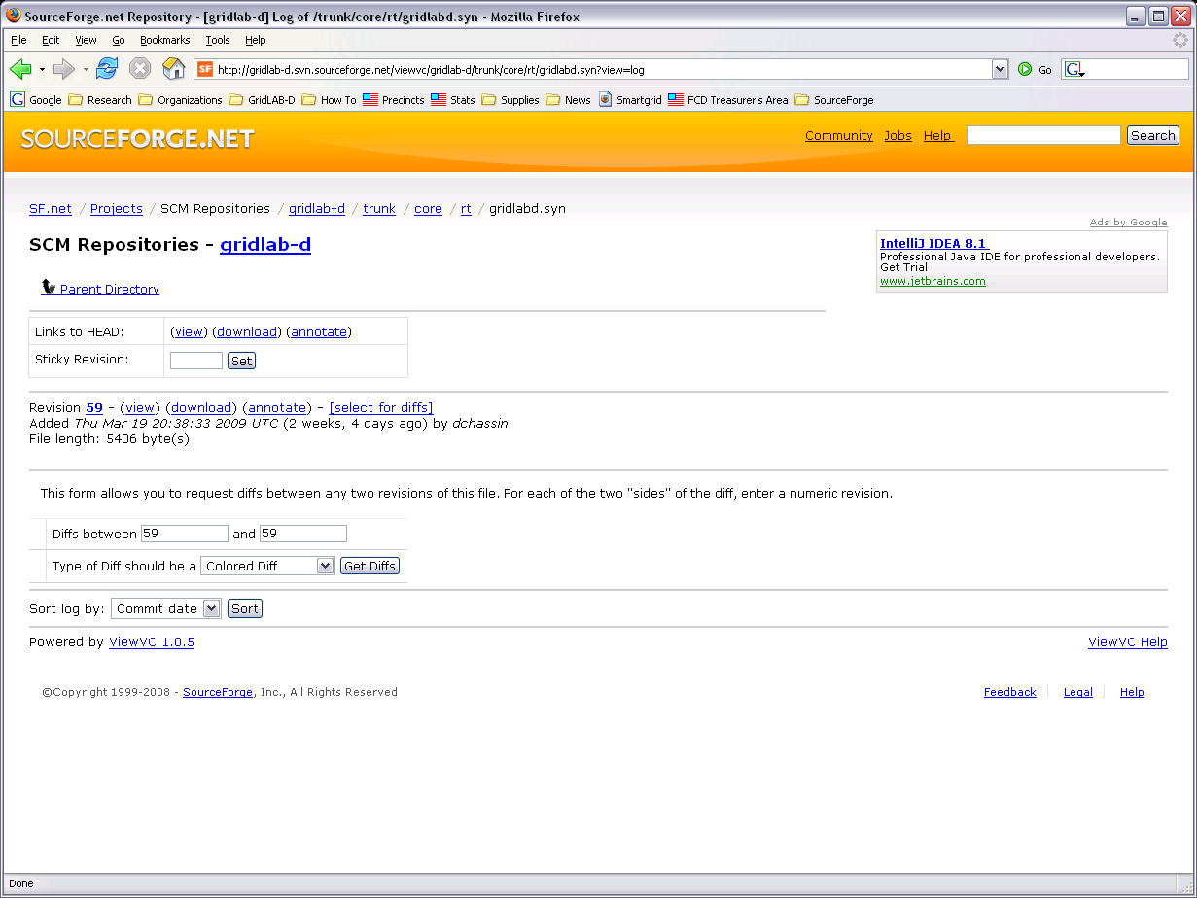

Slide 20
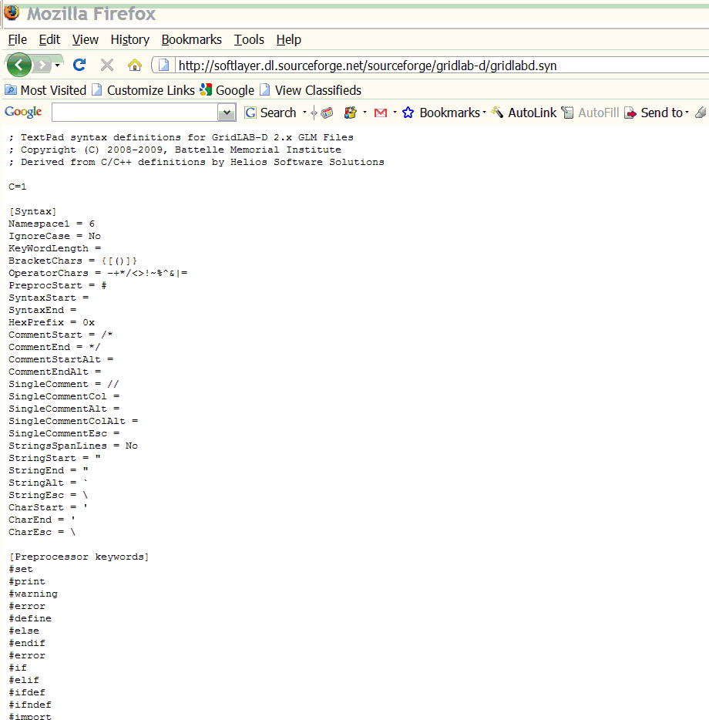

Slide 21
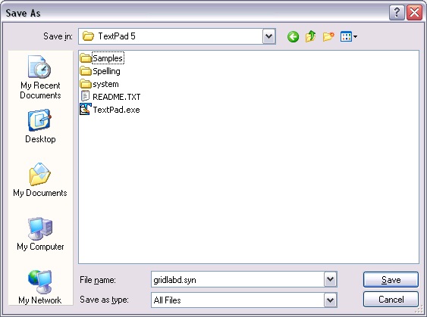
If you are unable to download the file, copy the definitions viewed in this page to C:\Program Files\TextPad5\system as gridlabd.syn
Notes:
Cannot download..need to copy and paste.

Slide 22
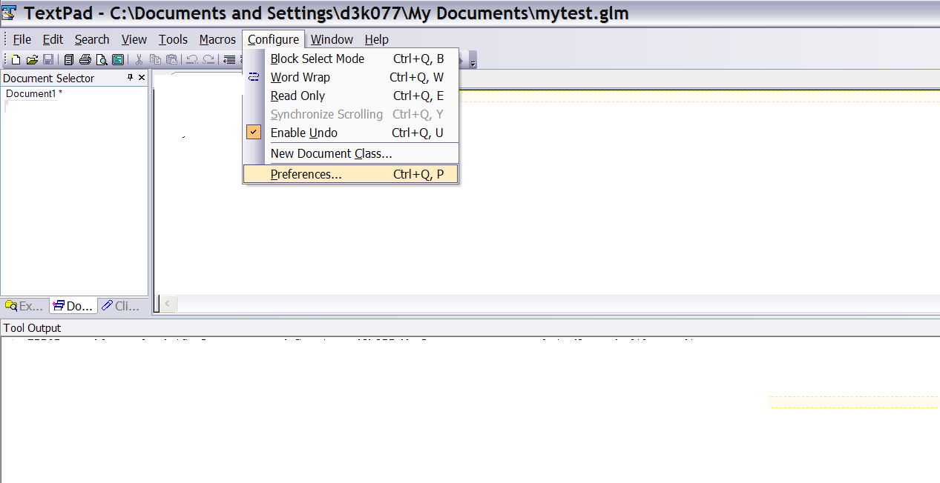

Slide 23
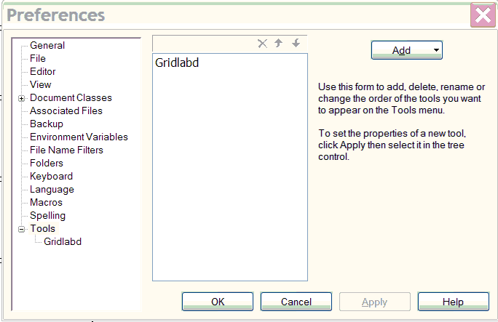
Create a GridLAB-D hotkey
Open TextPad5. Click on Configure/Preferences
Notes:
Need a print screen of TextPad and then Preferences.

Slide 24
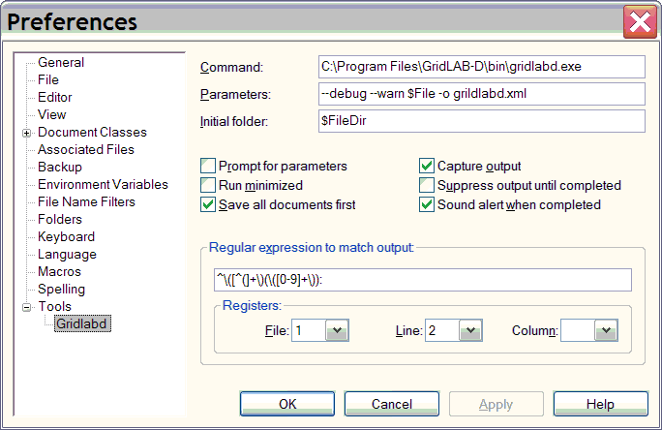
Define GridLAB-D hotkey action

Slide 25
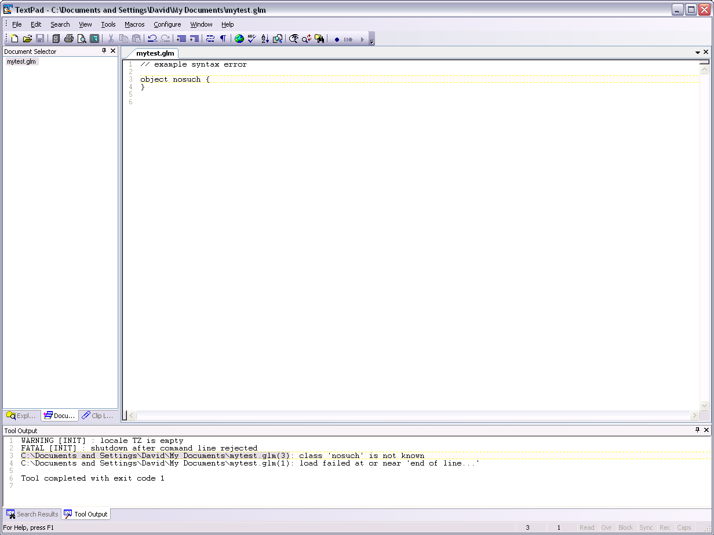
Notes:
Click

Slide 26
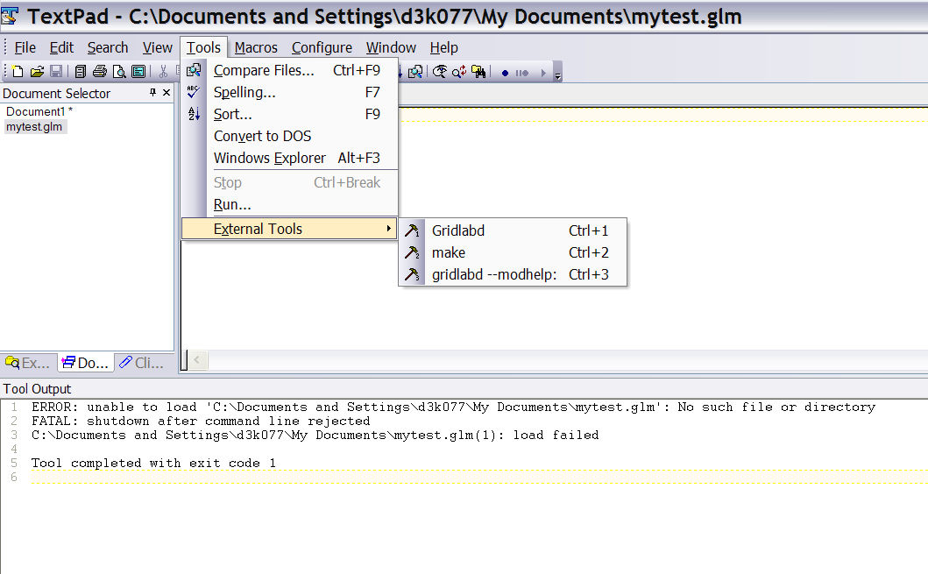

Slide 27
Exercises 1.2
Install your system and run the command:
host% gridlabd --dsttest
What happened?
Create a file with a bogus object and run it. Use the F4 key to find the error.

